Slide 1
How to Handle
Python Interview

Slide 2

Introduction of Speaker
https://www.linkedin.com/in/david-feng-xue-52197619/
Notes:
5 min self introduction, 2-3 min check the class audience on their background, and career planning

Slide 3
Part(I) Basic Concept
What is Python
Python usage
How to learn Python
Notes:
The strucutre of this session: 30 min to review some basic concpet of python and in general programing, take a 10 min break; 1 hour we talk about some real example of pyton interview quesiton, or some issue as begininer might face when using python; another 1h free Q&A session to understand their concern, quetions, thinking in terms of job career related

Slide 4
If Google “python interview quesiton” ...
What is Python? ...
What is a dynamically typed language? ...
What is an Interpreted language? ...
What is PEP 8 and why is it important? ...
What is Scope in Python? ...
What are lists and tuples? ...
What are the common built-in data types in Python? ...
What is pass in Python?

Slide 5
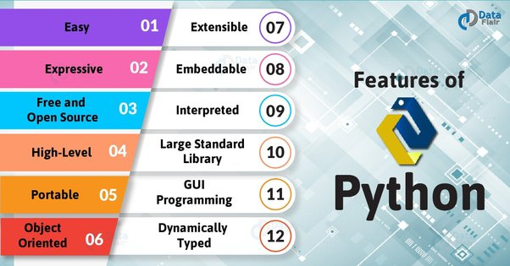
What is Python
Notes:
5 min

Slide 6
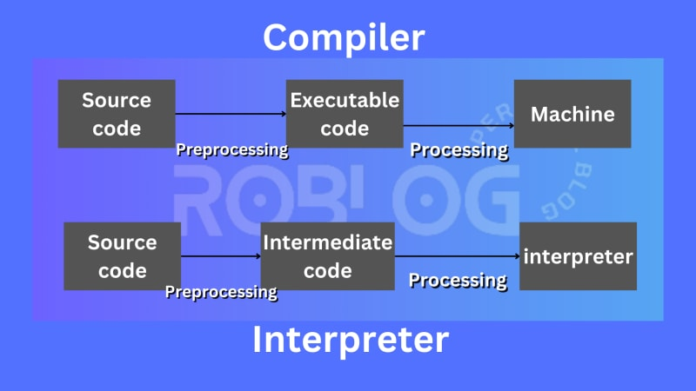
Python interpreter
Compiler | Interpreter
Takes entire programe in one-go | Line by line
generate machine code | does not generate
c, c++, c#, java | python, php, perl
https://www.youtube.com/watch?v=e4ax90XmUBc
https://www.tutorialsmate.com/2020/08/difference-between-compiler-and-interpreter.html

Slide 7
Dyanmically typed
Dynamic vs Static
Dynamic: This means that the Python interpreter does type checking only as code runs, and the type of a variable is allowed to change over its lifetime.
Static: Static type checks are performed without running the program. In most statically typed languages, for instance C and Java, this is done as your program is compiled. The type of a variable is not allowed to change over its lifetime.
Extra reference: https://realpython.com/lessons/dynamic-vs-static/
Notes:
5min

Slide 8
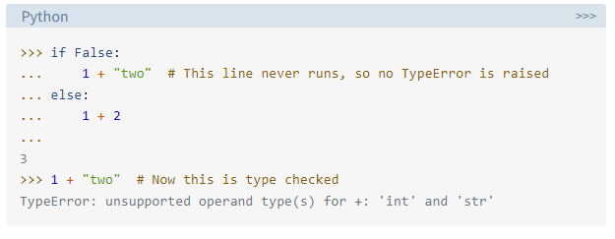
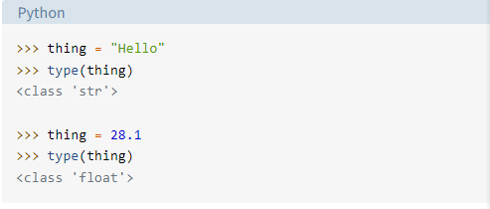
Dyanmically typed

Slide 9
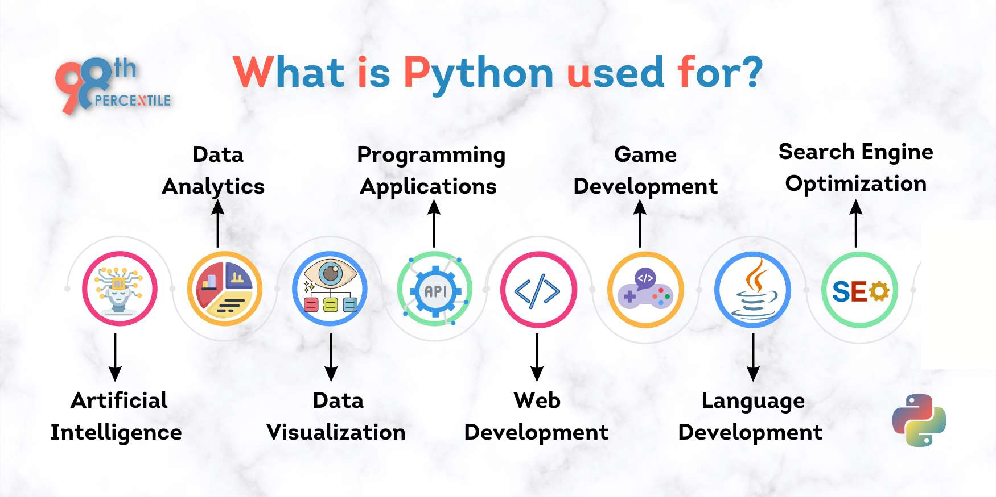
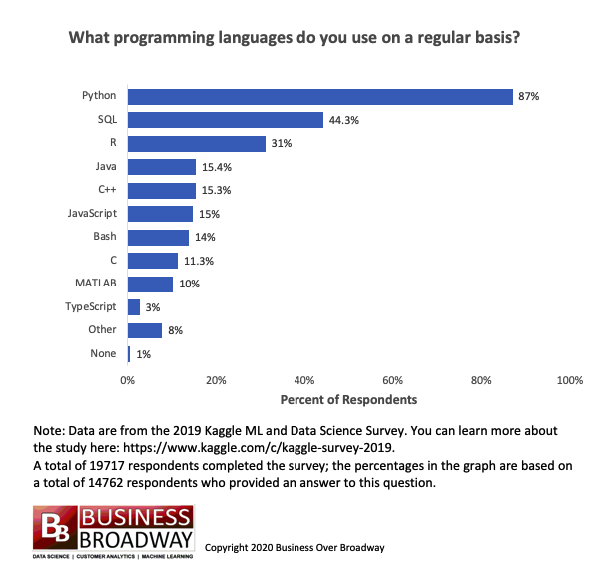
Python Usage
Notes:
take a pause check if anyone is using python for data science study

Slide 10
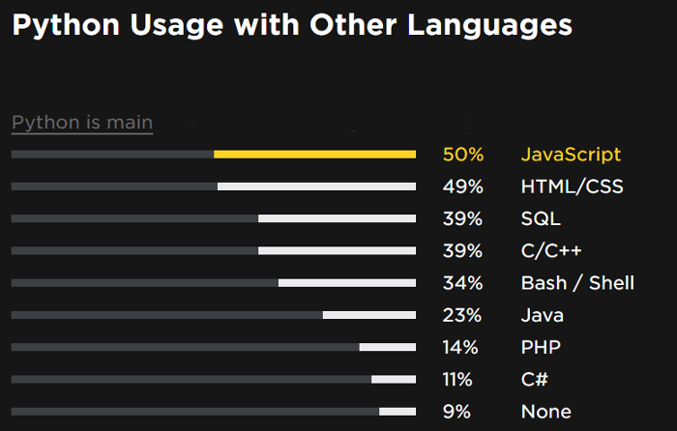
Python Usage

Slide 11
How to learn python
Beginer: https://realpython.com/
Offical reference document: https://docs.python.org/3/tutorial/index.html
Tons of tutorial on different python sub subject and levels
IDEs
Hands-on
End to end
Notes:
the language is still evolving

Slide 12
Part(II) Interview Question Examples
Group 1 on container data types
array, list & tuple
set, frozenset
dictionary
str

Slide 13
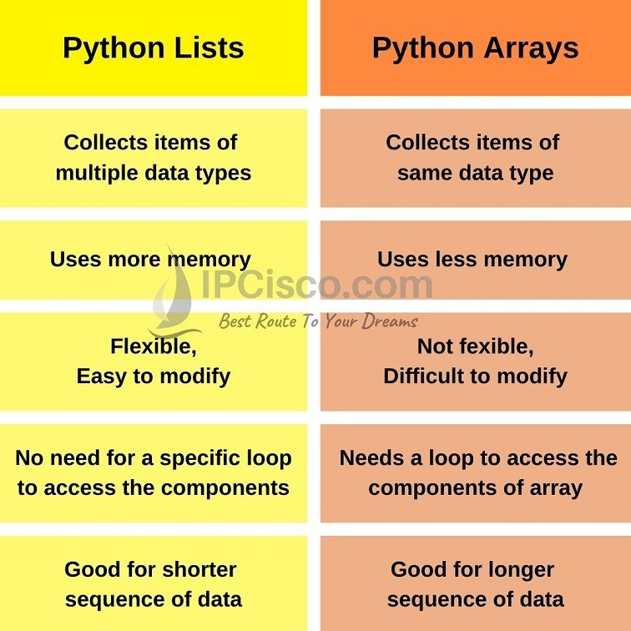

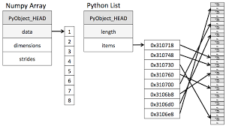
array vs list
Notes:
think about the operation comptuer need to access an item in array vs list

Slide 14
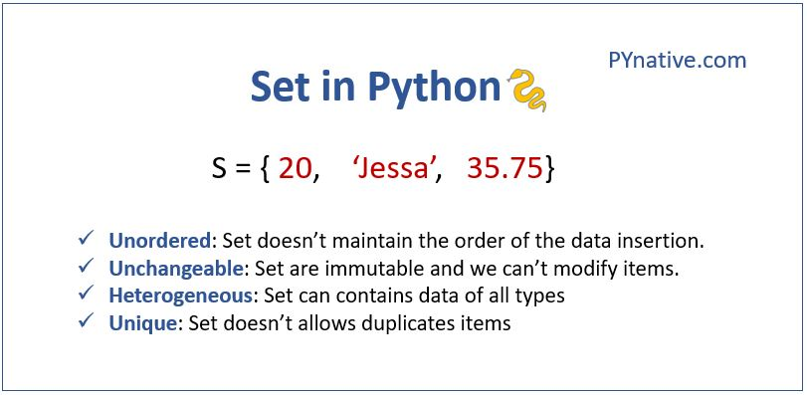
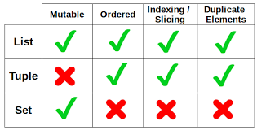
array vs list vs set

Slide 15
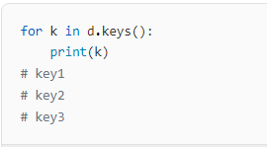
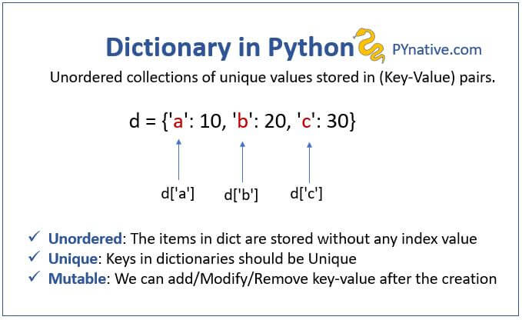
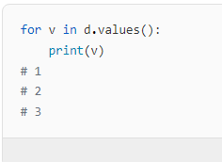
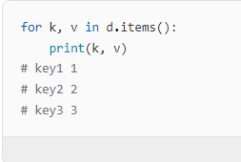
dictionary

Slide 16
Part(II) Interview Question Examples
Group 2 namespaces, module, packages
python namespaces
module vs packages
local vs global variable
example of cross import

Slide 17
Namespace and scope
Build in: >>> dir(__builtins__)
Global: contains any names defined at the level of the main program. Python creates the global namespace when the main program body starts, and it remains in existence until the interpreter terminates
Enclose & Local: the interpreter creates a new namespace whenever a function executes. That namespace is local to the function and remains in existence until the function terminates

Slide 18
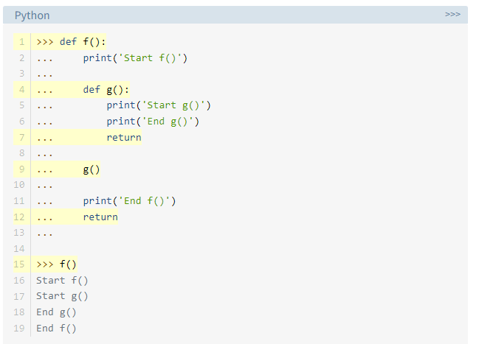
Namespace and scope

Slide 19
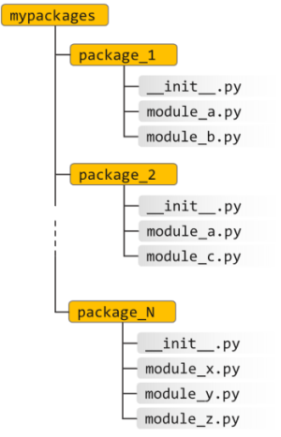
Module vs Package
A module is a single file (or files) that are imported under one import and used. e.g
import my_module
A package is a collection of modules in directories that give a package hierarchy
from my_package.timing.danger.internets import function_of_love

Slide 20
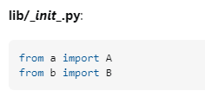
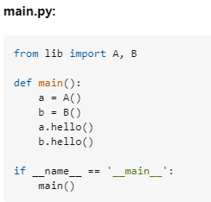
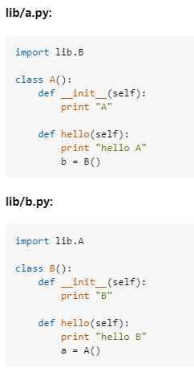
Example of cross import
Notes:
code example 5min - 10min

Slide 21
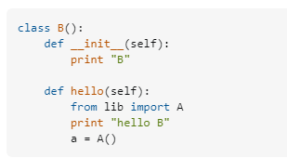
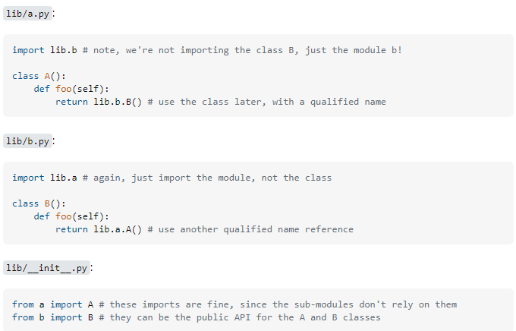
Example of cross import

Slide 22
Part(II) Interview Question Examples
Group 3 python environment
pythonpath
__main__
*arg, and **kwarg
how to read debug info

Slide 23
Part(II) Interview Question Examples
Group 4 OOP related
what is OOP and why OOP
how to create a class
__init__
__super__
python garbage collection
Notes:
example code 5min - 10min

Slide 24
OOP
Class and object
Attribute and method
Instantiate with __init()__
Constructor and destructor

Slide 25
OOP example of veichle and car class
class Vehicle:
def __init__(self,driver,wheels,seats):
self.driver = driver
self.noofwheels = wheels
self.noofseats = seats
class Cab(Vehicle):
pass
cab_1 = Cab('Sandy',4, 2)
cab_1.driver

Slide 26
OOP example of veichle and car class
class Vehicle:
minimumrate = 50
def __init__(self,driver,wheels,seats):
self.driver = driver
self.noofwheels = wheels
self.noofseats = seats
class Cab(Vehicle):
minimumrate = 75

Slide 27
OOP example of veichle and car class
class Vehicle:
minimumrate = 50
def __init__(self,driver,wheels,seats,kms,bill):
self.driver = driver
self.noofwheels = wheels
self.noofseats = seats
self.running = kms
self.bill = bill
def rateperkm(self):
return self.bill/self.running
class Cab(Vehicle):
minimumrate = 75
def __init__(self,driver,wheels,seats,kms,bill,cabtype):
Vehicle.__init__(self,driver,wheels,seats,kms,bill)
self.category = cabtype
class Bus(Vehicle):
minimumrate = 25
def __init__(self,driver,wheels,seats,kms,bill,color):
Vehicle.__init__(self,driver,wheels,seats,kms,bill)
self.color = color
can replace this command Vehicle.__init__(self,driver,wheels,seats,kms,bill) with super().__init__(driver,wheels,seats,kms,bill). super() is used to refer the parent attributes and methods.

Slide 28
OOP example of construtor and desctrutor
class Employee:
# Initializing
def __init__(self):
print('Employee created')
# Calling destructor
def __del__(self):
print("Destructor called")
def Create_obj():
print('Making Object...')
obj = Employee()
print('function end...')
return obj
print('Calling Create_obj() function...')
obj = Create_obj()
print('Program End...')

Slide 29
Part(II) Interview Question Examples
Group 5 algorythm related
O(n) example: fibonacci
Sorting example
Generator
Recursive exmaple
Decorators
Referece https://www.fullstack.cafe/interview-questions/

Slide 30
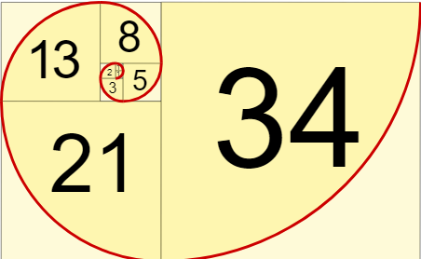
find Nth value in a Fibonacci sequence
0, 1, 1, 2, 3, 5, 8, 13, 21, 34, ...
https://www.mathsisfun.com/numbers/fibonacci-sequence.html

Slide 31
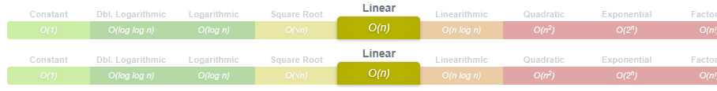
Python implementation
def fib_iterative(n):
a, b = 0, 1
while n > 0:
a, b = b, a + b
n -= 1
return a

Slide 32
Sorting example (i)
Bubble Sort is based on the idea of repeatedly comparing pairs of adjacent elements and then swapping their positions if they are in the wrong order. Bubble sort is a stable, in-place sort algorithm.
How it works:
In an unsorted array of n elements, start with the first two elements and sort them in ascending order. (Compare the element to check which one is greater).
Compare the second and third element to check which one is greater, and sort them in ascending order.
Compare the third and fourth element to check which one is greater, and sort them in ascending order.
...
Repeat steps 1–n until no more swaps are required.

Slide 33
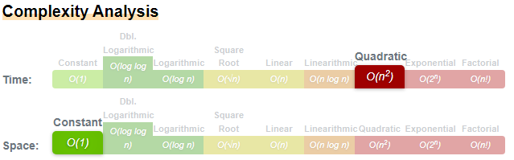
Sorting example (i)
def bubbleSort(arr):
n = len(arr)
# Traverse through all array elements
for i in range(n):
# Last i elements are already in place
for j in range(0, n-i-1):
# traverse the array from 0 to n-i-1
# Swap if the element found is greater
# than the next element
if arr[j] > arr[j+1] :
arr[j], arr[j+1] = arr[j+1], arr[j]

Slide 34
Sorting example (ii)
Insertion Sort is an in-place, stable, comparison-based sorting algorithm. The idea is to maintain a sub-list which is always sorted. An element which is to be 'insert'ed in this sorted sub-list, has to find its appropriate place and then it has to be inserted there. Hence the name, insertion sort.
Steps on how it works:
If it is the first element, it is already sorted.
Pick the next element.
Compare with all the elements in sorted sub-list.
Shift all the the elements in sorted sub-list that is greater than the value to be sorted.
Insert the value.
Repeat until list is sorted.

Slide 35
Sorting example (ii)
def insertionSort(array):
for step in range(1, len(array)):
key = array[step]
j = step - 1
# Compare key with each element on the left of it until an element smaller than it is found
# For descending order, change key<array[j] to key>array[j].
while j >= 0 and key < array[j]:
array[j + 1] = array[j]
j = j - 1
# Place key at after the element just smaller than it.
array[j + 1] = key
data = [9, 5, 1, 4, 3]
insertionSort(data)
print('Sorted Array in Ascending Order:')
print(data)
Notes:
code example

Slide 36
Generator
What is genertor?
Return vs Yield
Generator expression or comprehension example
Generator functions
Comparison with loop through List
Notes:
code example

Slide 37
Decorator
What is decorator?
A decorator is a design pattern in Python that allows a user to add new functionality to an existing object without modifying its structure. Decorators are usually called before the definition of a function you want to decorate.
Example
Notes:
code example

Slide 38

Part(III) Q&A

Slide 39
SMU 2023
David Xue
Presented
One raffles quay
Phone : 91076920
fxuehit@gmail.com

